Slide 1
CHEAPER EXCHANGE OF INFORMATION VIA WIRELESS TECHNOLOGY
Supervisors:
Dr. Petronilla Muriithi
Prof. Waweru Mwangi
KAIRU JOSHUA WAMBUGU – CS281-0720/2011
Notes:
<number>

Slide 2

What Do We Expect?
Some background
System Analysis and Design diagrams
A laugh maybe?

Slide 3

Background and Introduction
A question.
How can smart phones connect and communicate with each other over wireless without
a third party?
Notes:
<number>

Slide 4

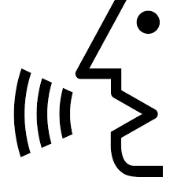

Background and Introduction (2)

Slide 5



System Analysis and Design Diagrams
The Network Topology Diagram
The Navigation Diagram
The Interaction Diagram

Slide 6
1) The Network Topology Diagram
Network Messages and Data
1
1
1
1
Network Messages and Data

Slide 7
2) The Navigation Diagram
Home
Activity
Make Call
Activity
Receive
Call Activity
Calling
Activity
Exit
Incoming
Call Activity
Call In Session
Activity
(Client Side)
Call In Session
Activity
(Server Side)

Slide 8

Literature Review
Four areas of concern:
Wireless Technologies
Peer-to-peer Technologies.
Audio Encoding Techniques.
Audio File Formats.
Notes:
<number>

Slide 9

Wireless Technologies
Three will be looked at:
Near Field Communication
Bluetooth
Wireless Fidelity
Notes:
<number>

Slide 10
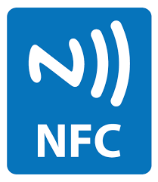
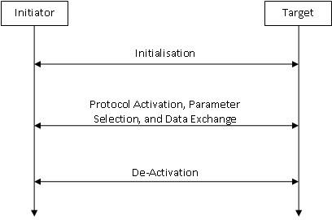
Near Field Communication(1)
Notes:
<number>

Slide 11
Near Field Communication(2)
Excels over short distances (maximum 10 cm)
Short distance
Relatively new technology
Only small quantities of data
Notes:
<number>

Slide 12
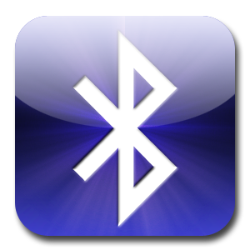
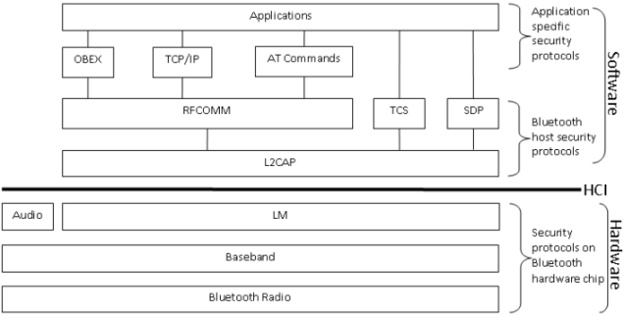
Bluetooth(1)
Notes:
Bluetooth radio. It transmits data in the form of bits by using a RF.
This functionality is defined in the radio layer. Bluetooth radio systems
generally use the Gaussian Frequency Shift Keying (GFSK) technique
to transmit and receive RFs.
• Baseband. This layer does frequency hopping for interference mitigation, medium access control, and data packet formation. In addition,
the Baseband layer also control link, channel, and error correction and
flow control.
• Link Manager (LM). This layer acts as a go-between for the application and the link controller in the local Bluetooth device. Remember,
the Baseband layer does link control.
• Audio. The audio layer is almost on the same level with the LM layer.
However, Audio is separated from LM so as to avoid the overhead of
upper layer protocols. This is important since the Audio layer hosts
protocols used to provide real time two way voice communication. The
separation of Audio from LM ensures voice communication does to experience lag due to LM protocols.
11
• Logical Link Control and Adaptation Protocol (L2CAP). This
protocol is on a layer of its own. It normally resides on the host. L2CAP
acts as a conduit for data on the connection link between the Baseband and host applications. L2CAP is used to ensure both connectionoriented and connection-less services. This protocol also initiates security services for any Bluetooth communication session.
• Radio Frequency COMMunication (RFCOMM). This is a transport protocol that is used to emulate RS-232 serial ports. It enables
Bluetooth devices to connect with external gadgets such as printers and
scanners.
• Telephony Control Specification (TCS). This protocol defines the
call control signalling needed for the establishment and/or release of
speech and data calls between Bluetooth devices. It also proved functionality for exchanging signalling information that is not related to
ongoing calls.
• Service Discovery Protocol (SDP). This protocol is essential since
it discovers the Bluetooth services available within the RF proximity
and determines the characteristics of the available services. SDP is what
allows Bluetooth devices to form ad-hoc, or peer-to-peer, networks.
• Object EXchange Protocol (OBEX). OBEX is used to exchange
objects between Bluetooth devices. These objects include calendar
notes, business cards, and data files. The exchange is done based on a
client-server model.
• Transport Control Protocol/Internet Protocol (TCP/IP). This
well-known protocol provides a reliable stream of data to Bluetooth
applications from the RFCOMM layer.
• ATtention (AT) commands. These are not protocols as such but
are a set of commands used in general telecommunications to produce
commands for management of communication sessions.
• Applications. These are the Bluetooth applications used by end users.
<number>

Slide 13
Bluetooth(2)
Flexibility – Hardware and software.
Quite common
Relatively small range of operation (30 m)
Security issues
Notes:
<number>

Slide 14

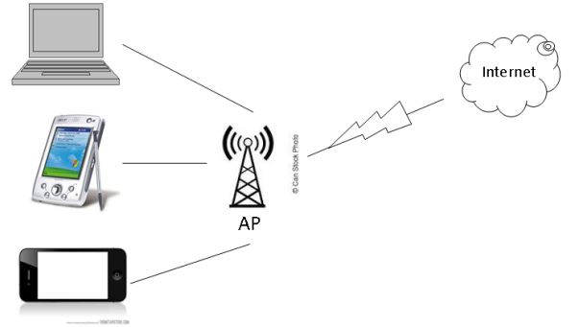
Wireless Fidelity (Wi-Fi)(1)

Slide 15
Wireless Fidelity (Wi-Fi)(2)
IEEE Standard | Maximum Speed (Megabytes per second) | Frequency (GigaHertz) | Backward Compatible with
802.11 | 2 | 2.4 | –
802.11a | 54 | 5 | –
802.11b | 11 | 2.4 | –
802.11g | 54 | 2.4 | 802.11b
802.11n | 600 | 2.4 and 5 | 802.11a/b/g

Slide 16
Wireless Fidelity (Wi-Fi)(3)
Longest range of the three technologies (maximum 100 m)
Very common
Security!!!
Power draw.

Slide 17

Peer to Peer Technologies
Two will be considered:
Short Message Peer to Peer protocol
Wi-Fi Direct

Slide 18
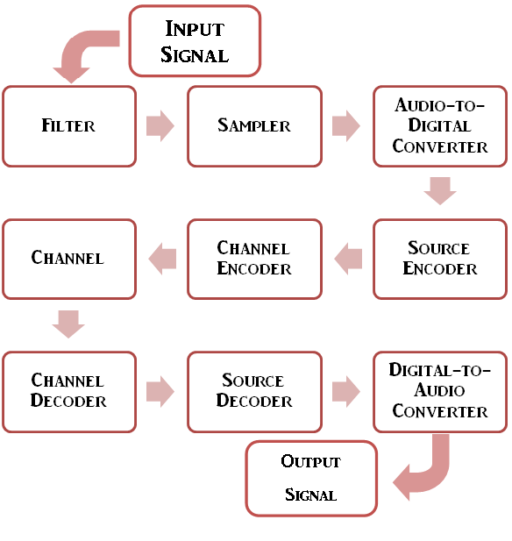
Audio Encoding Techniques
How is audio converted from
analog to digital?
Two ways:
Adaptive Multi-Rate Narrow Band (AMR-NB)
Adaptive Multi-Rate Wide Band
(AMR-WB)
Notes:
Difference is the quality and the acceptance.
<number>

Slide 19
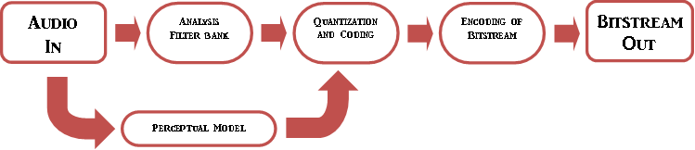
Audio File Formats(1)
Perceptual coding – Mind games.

Slide 20
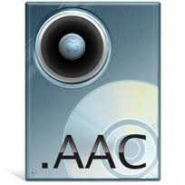

Audio File Formats(2)
Two common formats:
Motion Picture Experts Group-1/2 Layer-3 (MP3)
Advanced Audio Coding. (AAC)

Slide 21

What Will We Use?
Four areas of concern and what we will use:
Wireless Technologies – Wi-Fi
Peer-to-peer Technologies – We will implement this
Audio Encoding Techniques – AMR-WB
Audio File Formats – AAC.

Slide 22

GSM
Hallmark of Mobile communication
Distance
Security
Cost

Slide 23

Research Methodology
Experimentation:
Connection
Vary distance.
Vary audio.
Web search:
StackOverflow
Code questions
Interviews:
University students
Get views after each major build

Slide 24

THANK YOU

